Slide 1
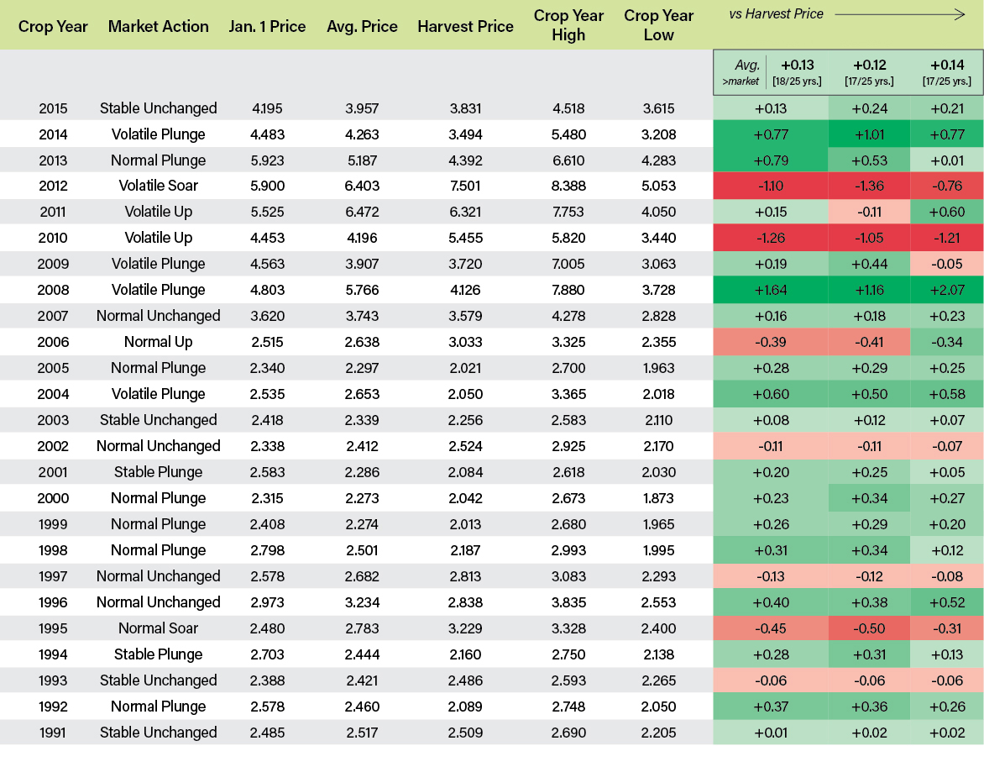
DISCIPLINED MARKETERTM PROFESSIONALLY MANAGED PRICING PROGRAMS
Hypothetical Backtested Performance Data [7/5/2016] | Standard Length Programs [Jan. 1 – Oct. 31]
*BACKTESTED data, not actual returns (before accounting for commissions and fees)
Benchmark
Criterion
Ultra
CONTACT [INSERT FIRM’S NAME] FOR MORE INFO: phone number | email address
© 2016 [insert firm’s name]. All Rights Reserved.
The risk of loss in entering into HTA contracts or trading commodity futures contracts can be substantial.
You should, therefore, carefully consider whether such contracts are suitable for you in light of your circumstances and financial resources.

Slide 2
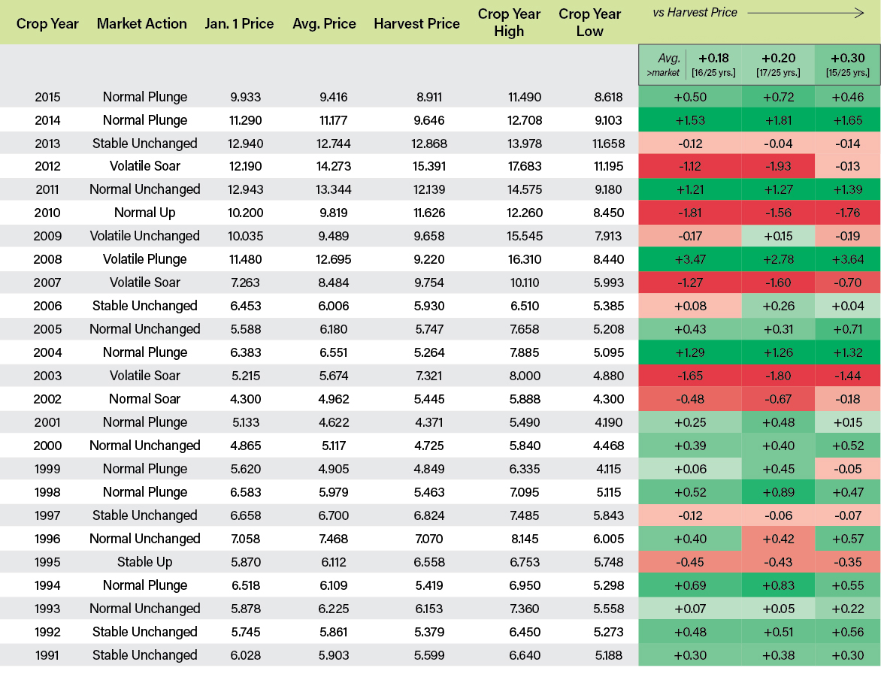
DISCIPLINED MARKETERTM PROFESSIONALLY MANAGED PRICING PROGRAMS
Hypothetical Backtested Performance Data [7/5/2016] | Standard Length Programs [Jan. 1 – Oct. 31]
*BACKTESTED data, not actual returns (before accounting for commissions and fees)
Benchmark
Criterion
Ultra
CONTACT [INSERT FIRM’S NAME] FOR MORE INFO: phone number | email address
© 2016 [insert firm’s name]. All Rights Reserved.
The risk of loss in entering into HTA contracts or trading commodity futures contracts can be substantial.
You should, therefore, carefully consider whether such contracts are suitable for you in light of your circumstances and financial resources.

